Slide 1
Running a Constitution
POSC 509-01
Foundations of public ADMIn

Slide 2
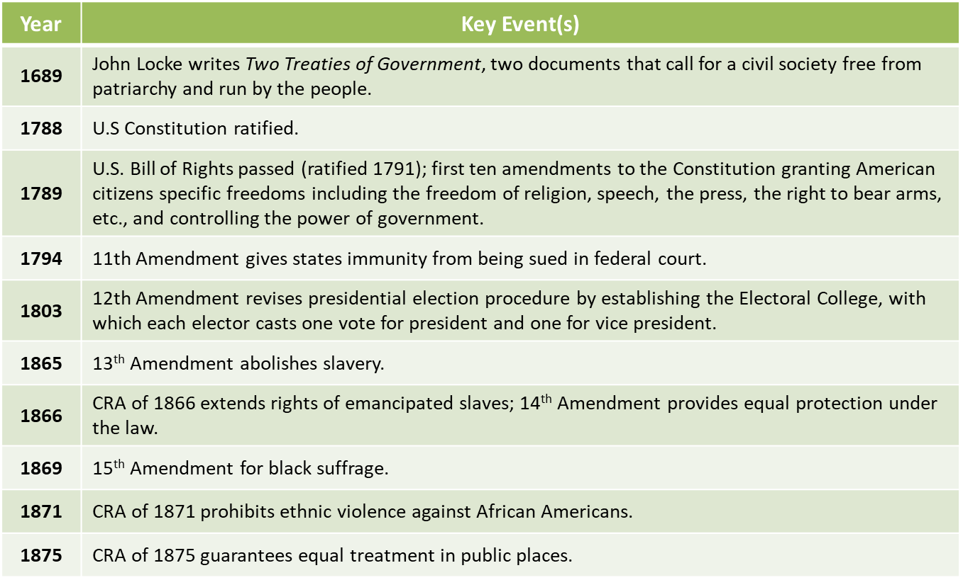
Timeline

Slide 3
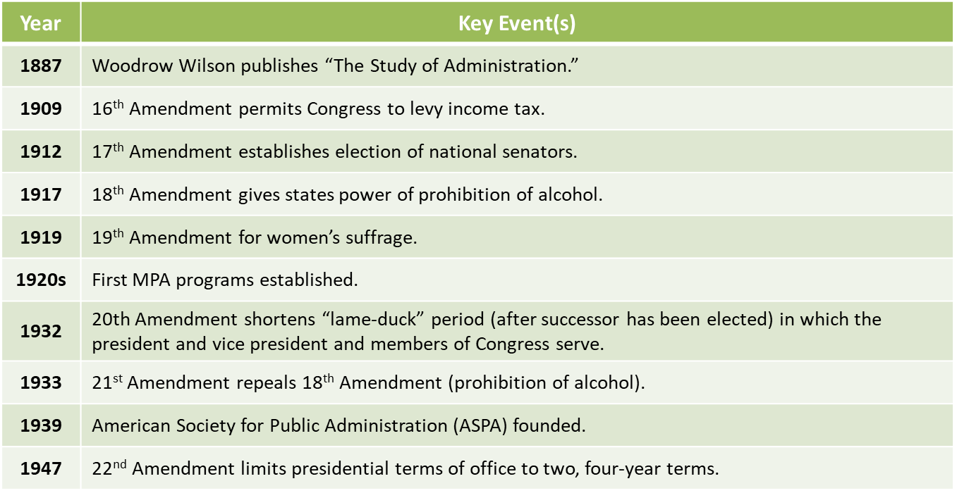
Timeline

Slide 4
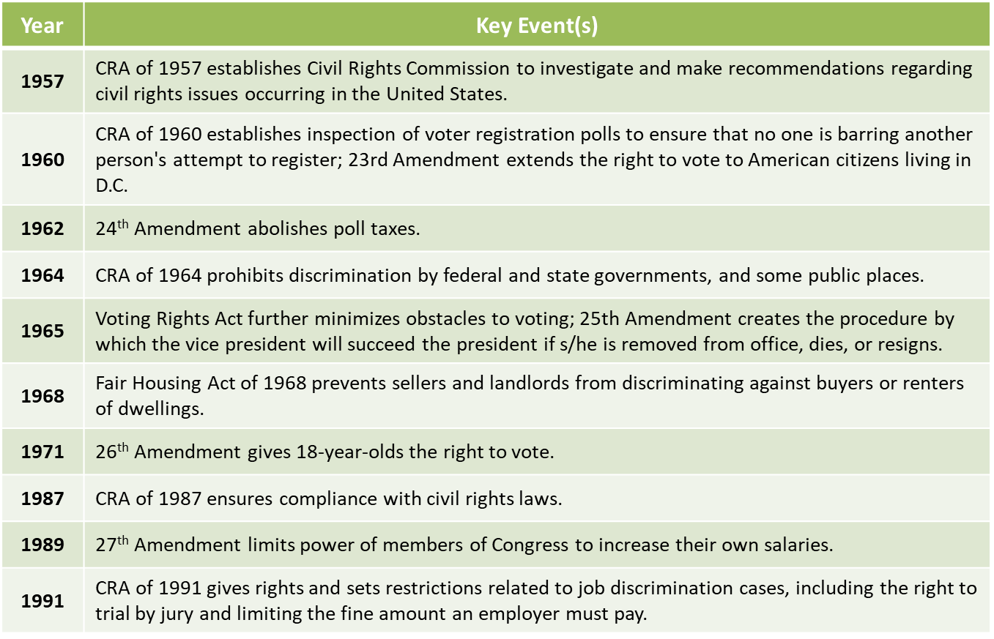
Timeline

Slide 5
Overview
The nature and context of public service
Intellectual roots of public administration and the field’s enduring debates
How government differs from business
The importance of social equity
The interdependence of government and nonprofits

Slide 6
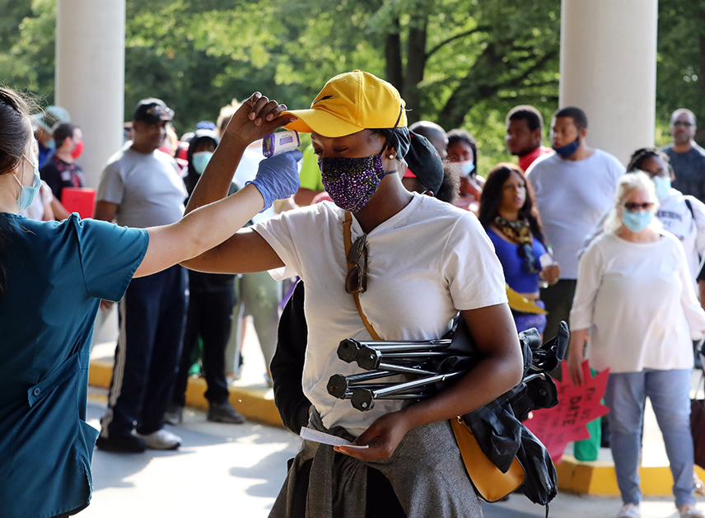
Global Pandemic
COVID-19 had a devastating effect on the global economy and prompted drastic changes in how we work and learn; business closures and the need to quarantine forced lifestyle changes.
As unemployment exploded and healthcare facilities became overwhelmed, we looked to government at the local, state, and federal levels for planning, coordination, regulation, and financial relief.
Public administration involves routine functions as well as crisis response.
Federalism continues to evolve.

Slide 7

Global Pandemic
How does level of government influence responses to the pandemic?
What is the relationship between government and business in pandemic response?
Why does government perform the safety net function?
How do nonprofits contribute to the pandemic response?

Slide 8
Public Administration Competencies
To lead and manage in public governance
To participate in and contribute to the policy process
To analyze, synthesize, think critically, solve problems, and make decisions
To articulate and apply a public service perspective
To communicate and interact productively with a diverse and changing workforce and citizenry

Slide 9
The Nature and Context of Public Service
Governance
The combination of authorities (government, nonprofit, and business) and the interests that provide direction for communities.
The U.S. model of governance entails:
Guidance by the Constitution, laws, and procedures
Three branches of government (executive, judicial, legislative) that perform checks and balances
The diffusion of power between federal, state, and local governments
The requirement of citizen engagement and transparency
Sectors of the economy (government, nonprofit, and private organizations) working together

Slide 10
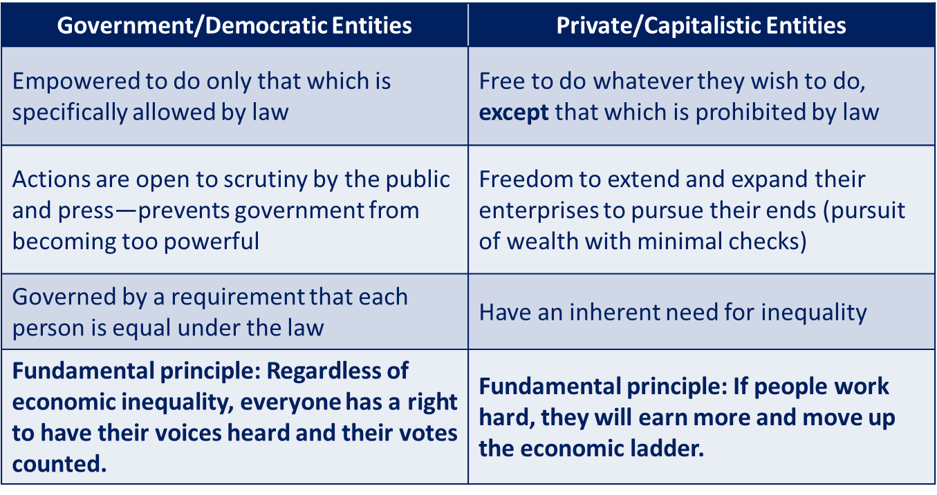
Making Democracy and Capitalism Work Together

Slide 11
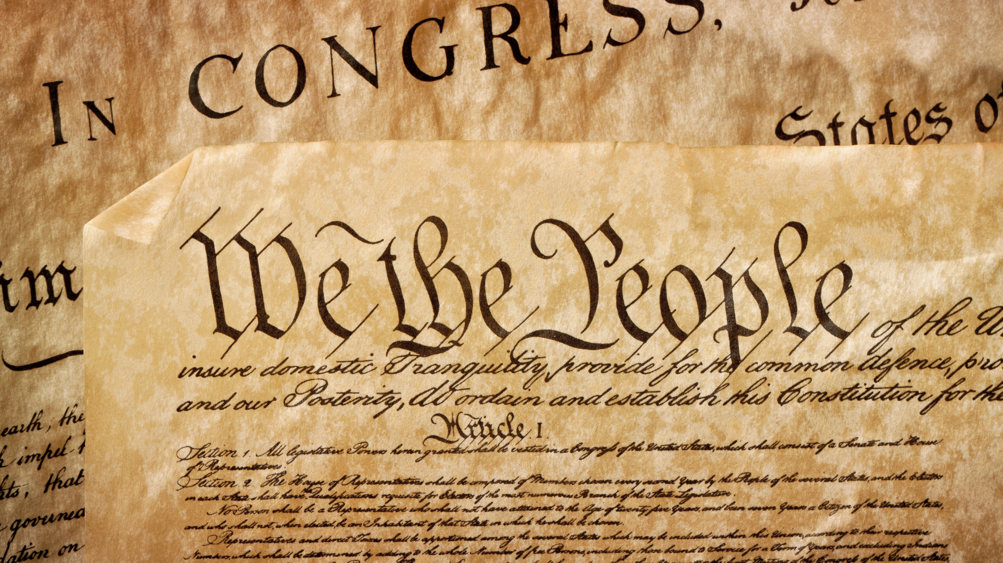
The Constitution of the United States
What does it have to say about public administration?
What applies to public administration?
What else is applicable?

Slide 12
Intellectual Roots of PA: The US Constitution
The separation of church from state
The separation of powers between branches of government
Self-government
A system of elections

Slide 13
Intellectual Roots of PA: The US Constitution
Laws regularize processes but allow businesses to flourish
Civil rights acts advance political equality
Formal, merit-based selection processes establish guidelines for civil service employment

Slide 14
Enduring Debates in Public Administration
Politics versus Administration
Facts versus Values
Public versus Private

Slide 15
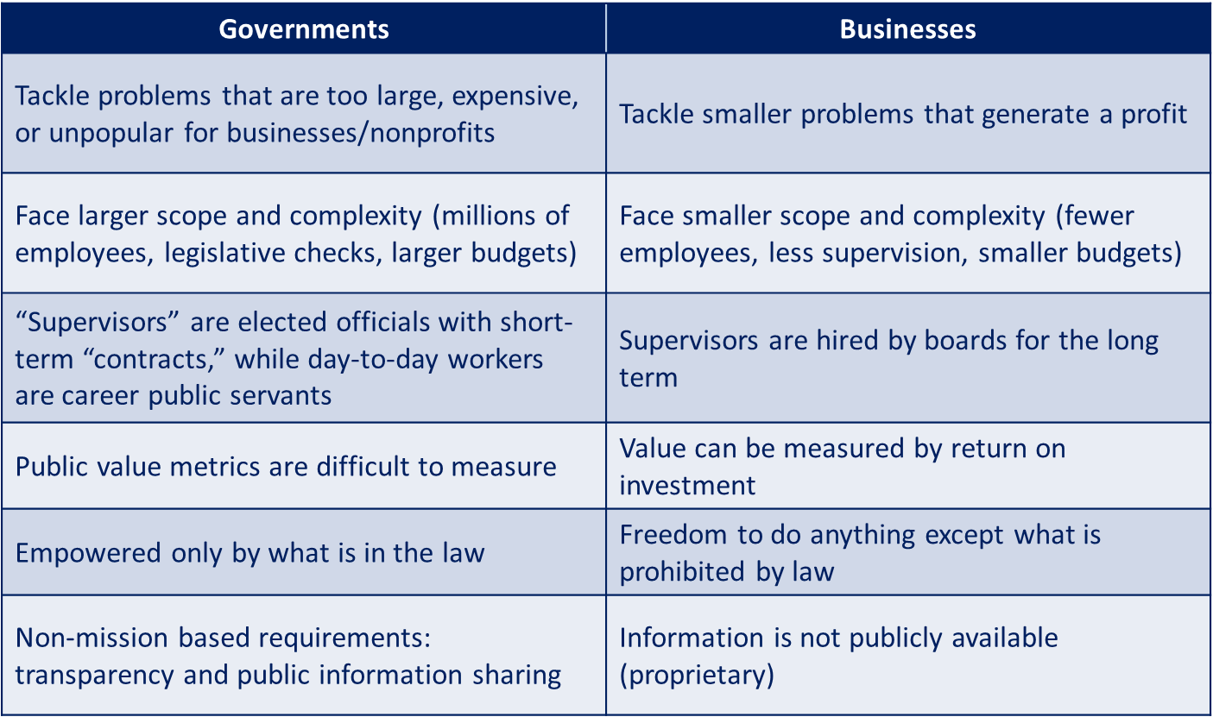
Public versus Private

Slide 16

Qualities of the public & Private Executive
Cognitive intelligence
Emotional intelligence
Self-confidence
Decisiveness
A sense of humor
Humility

Slide 17
Public Executives
Respond to the needs of elected officials, who are changing all the time
Follow a code of ethics stricter than that expected of business executives

Slide 18
Code of Ethics for Public Administrators
Advance the public interest
Uphold the Constitution and the law
Promote democratic participation
Strengthen social equity
Fully inform and advise
Demonstrate personal integrity
Promote ethical organizations
Advance professional excellence

Slide 19
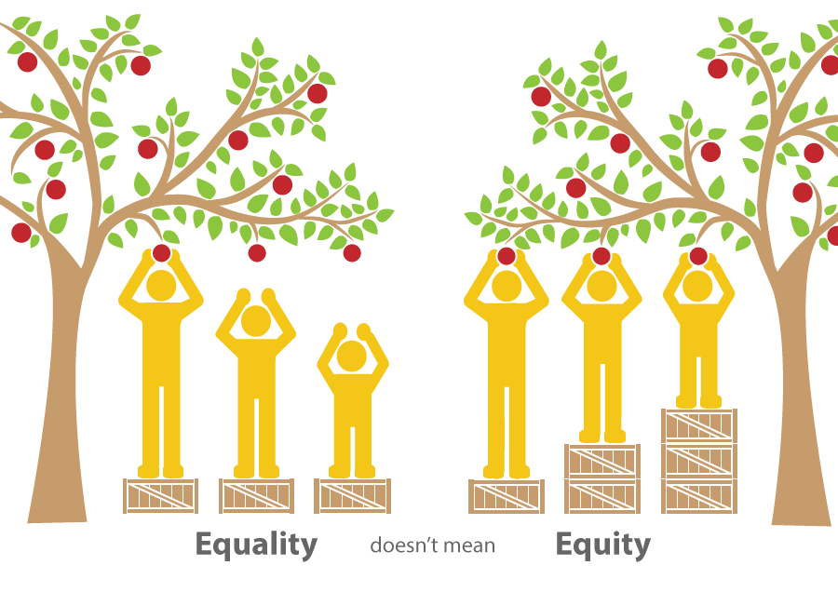
Equality versus equity
Equality: Having equal parts, identical in size or number.
Equity: Pertaining to the distribution of fairness.

Slide 20
Nonprofits
Provide services that address the needs of the people and empower them to change policy
Represent public interests to government
Analyze data and contribute to policy debates
Deliver health and human services
Governments, philanthropies, and the public fund nonprofits

Slide 21
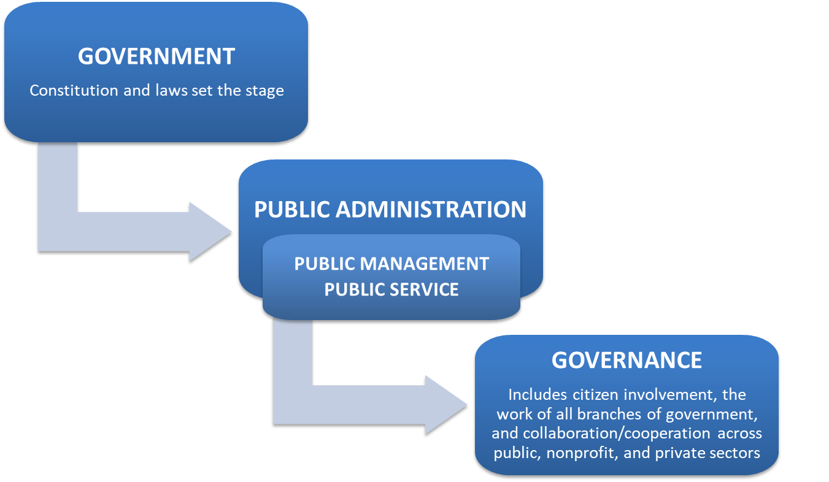
Linguistics of the Field: Related Terms

Slide 22
Summary
Public Service requires many skills:
Legal
Interpersonal
Technical
Managerial
Public administration is a multi-disciplinary field, drawing expertise from a variety of specialties to tackle large, complex, and expensive problems.

Slide 23
Summary cont’d
Public administration relies on civic engagement and cooperation/collaboration between government, nonprofits, and businesses.
Public administration often relies on federalism to accomplish goals and carry out programs
The ultimate goal of public administration is to responsibly facilitate constitutional democracy through resilient governance; this calls for an expert workforce and requires confidence in people and public institutions.

